Slide 1
Case Study ABC Systems
Business Requirement document
X Group of Hotels

Slide 2
Case Study Checklist – Prep Work
Read the case study to understand goal/objective of system build/enhancement
Understand what deliverables seems required as part of case study
Understand SDLC format( Waterfall vs Agile)
Ask questions about case study(if you can)
Case Study Checklist – Actual Work Required
Document assumptions
Create Use Case Diagram to identify major functions/interactions/users/systems of the project
Create As-Is workflow diagram to showcase current state
Create To-Be workflow diagram to showcase future state
Create requirements for future state/User Stories/Acceptance Criteria
Create Prototypes
Present Case Study

Slide 3
Case Study Scenario.
ABC Systems
ABC systems is one of the TOP companies in providing software for hotel Industry
So Cleaning & sanity has become most important ,because of COVID .In one of my freelance project client has a chain of hotels requested to create system which allows following:
Cleaning-staff : a person who have our app installed on mobile phone. Cleaning staff visits locations/room assigned to him and clean the room.
Supervisor: A person who verifies the work of cleaning Staff
Admin: A person who assign location/room to cleaning staff and assign supervisor to rate same.

Slide 4
Case Study Scenario..
Our requirement
The cleaning-staff on start of his shift login to the app. He visits room/location which has been assigned to him by Admin. He Start the timer while selecting the location. He does the cleaning and fill the checklist with the comments if any. Once done ,he submits the report and mark the task complete. And so on.
The Supervisor visit the rooms/locations assigned to him. He pullout the details of his staff who cleaned to location. He verifies the work and assign a rate to each item . Once done, he finally Rate the Work.
Your Task
You need to write SRS ( System requirement Specifications) with Functional Point and Wireframe for Web application.

Slide 5
ABC Systems – Prep Work
Goals & Objectives: Building mobile app to help manage and track progress of cleaning staff for a group hotels
Deliverables : User Stories , Wireframes(prototyping) ,( Mentioning API to process data further)
SDLC : Agile
Ask Questions?:

Slide 6
ABC Systems – Assumptions
Mobile app should work on Apple/Android
Mobile X- Group of Hotels
X- Hotels has 7 hotels in the same state with the same time zone
1 Supervisor per hotel
Each hotel as 150 rooms
Cleaning Staff Shifts- 2 ( Morning & Evening)

Slide 7
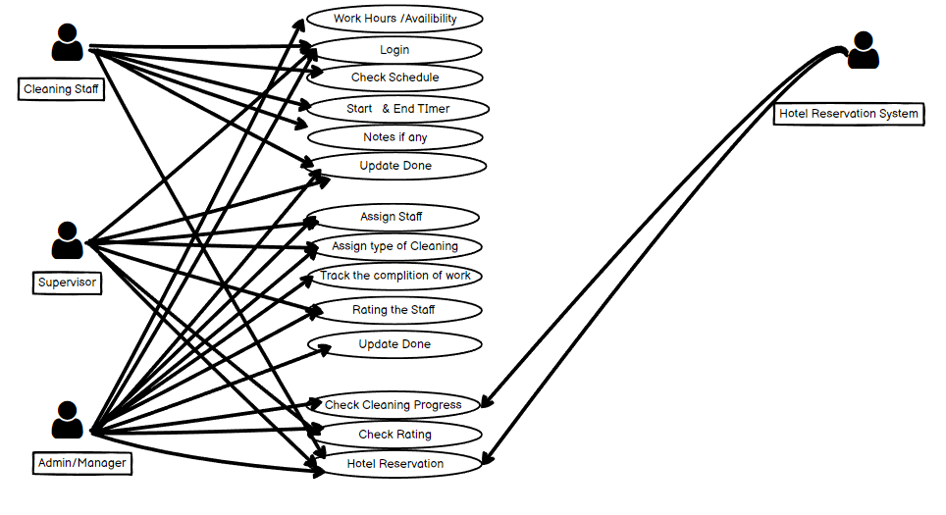
ABC Systems – Use Case Diagrams

Slide 8
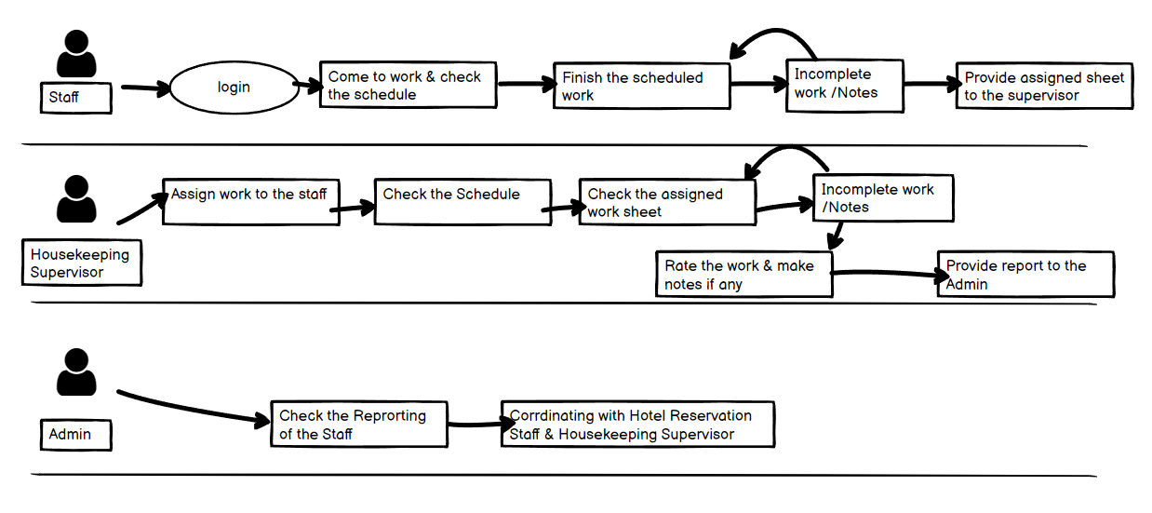
ABC Systems – As-Is Workflow

Slide 9
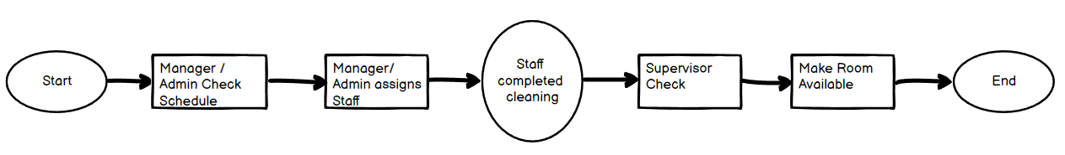
ABC Systems – To- Be Workflow

Slide 10
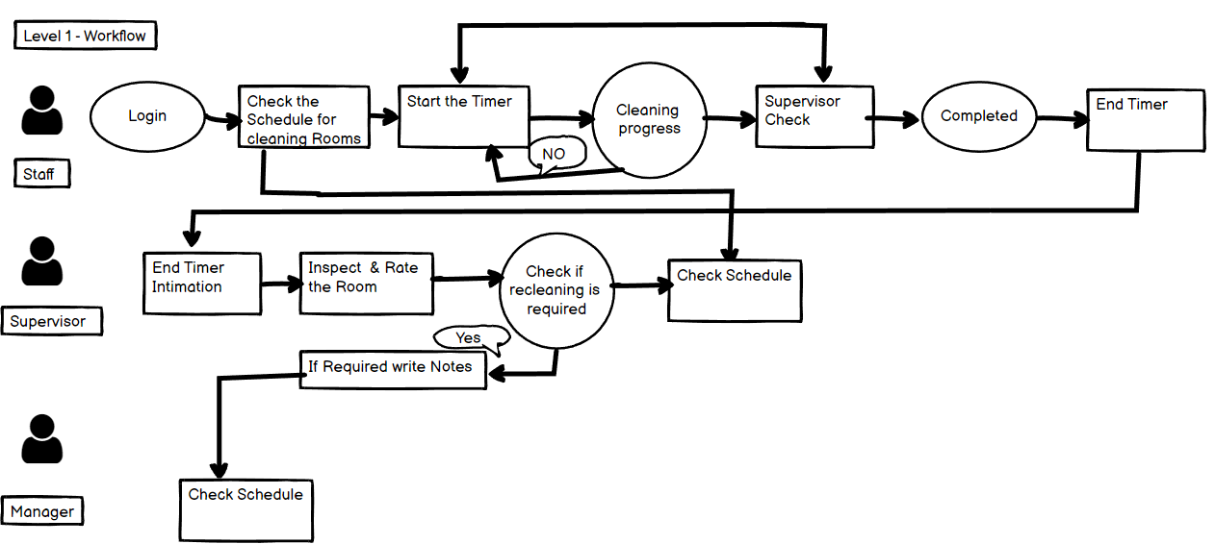
ABC Systems – To- Be Workflow

Slide 11
ABC Systems – Product Backlog
Mobile app should work on Apple/Android
Input Available hours/shift timing
Login- Staff, Supervisor, Admin/Manager
Timer – When Starting Cleaning
Notes – Staff, Supervisor, Admin/Manager
Update Checklist - Supervisor
Assign Staff to Rooms – Admin/Manager, Supervisor
Assign Type of Cleaning – Admin/Manager
Rating Staff - Admin/Manager, Supervisor
Create Schedule – Admin/Manager , Supervisor
Reporting – Admin/Manager
Reservations – Admin/Manager, Supervisor
Maintenance Request – Staff, Supervisor, Admin/Manager

Slide 12
Framework of case.
Document Assumptions
Create As – Is workflow diagram
Done by interviewing stakeholders
Identifying current pain points
Expected Results/Enhancements
Create Use Case Diagrams
High level Features
Identify Business Rules
Create To-Be workflow diagram
Create requirements for future state/User Stories/Acceptance Criteria
Create Prototypes
Present Case Study

Slide 13
Identify Business Rules
Business Rule – Rule of Particular industry
5 or less rooms assigned to cleaning staff per day
Supervisor & Admin required before assigning room to guest
Type of Cleaning
1 Deep Cleaning
Daily Cleaning
Deep Cleaning = Change sheets, Clean bathroom and etc
Daily Cleaning = Make bed, add inventory items(coffee , water) and etc

Slide 14
Thank You

Slide 16
ABC Systems – As-Is Workflow

